Slide 1
BellaBeat Case Study Presented By: Jenna Brauer

Slide 2
Roadmap
Business Task
About the Data
Analysis
Visuals
Conclusions

Slide 3
Business Task
In this case study, I was asked to analyze data pertaining to user trends in the realm of smart fitness devices. I was then to use my insights to help a real fitness device company, Bellabeat, develop a marketing strategy to take advantage of these trends in marketing their products to the public.

Slide 4
About The Data
Provided dataset included data from 30 Fitbit users who opted to have data collected directly from their devices
Spans the time period of 03/12/2016 to 05/12/2016
Data split into two folders covering half of this time period
Tables include daily activity, heartrate, sleep data, weight data, intensity, and calories
Not all users have data in every table, nor do they necessarily have data for the full time period
This data is in the public domain
All tables are in the “long” format

Slide 5
Data Processing (1/5)
Decided to use BigQuery to process my data
Began by manually uploading all tables into a single project in BigQuery
Kept the tables organized by date range 3/12-4/12 and 4/12-5/12
For all tables that were represented in both date ranges and had identical column names and types, I used UNION ALL to combine the two date ranges and saved the result as a new table¹
Addressed the presence of duplicate data by doing a SELECT DISTINCT query and saving the result as a new table²
From here I moved on to focusing on tables individually

Slide 6
Data Processing (2/5) daily Activity
Focused first on the dailyActivity table
After combining the two tables from each date range and removing duplicates I ran a query³ to count the number of daily records for each user
Determined that each user has a widely different number of records
Ran a query to determine the number of users who had data available by date⁴
This revealed that few users had data for March 12th-31st and for May 1st-May 12th but many had data for the month of April
Decided to run a query that would pull only the April data⁵
Since both datasets that were combined had data for 4/12 and it was not possible to determine if this was duplicate data or split data, I decided to remove data for 4/12 only⁶

Slide 7
Data Processing (3/5) daily Activity
Next, I ran a query to determine which users had data for all of April (in this case, 29 days of data since I removed 4/12)⁷
This produced a table with complete data for the month of April for 22 users. I then used this clean data for my analysis, primarily in Google Sheets

Slide 8
Data Processing (4/5) Heartrate Seconds
These tables contained heartrate values for users by the second
BigQuery did not recognize the “Time” column as a datetime field while trying to upload the table
Manually selected a STRING field type for this column when creating table
Wrote a query that would parse the date and time data from the STRING field and then used CAST to make the new field DATETIME⁸
Ended up using this same query for several of the tables that had incompatible datetime fields
Combined the two halves of the heartrate data with UNION ALL
Got rid of duplicates by running a SELECT DISTINCT query and saving the result

Slide 9
Data Processing (5/5) Other TAbles
Used UNION ALL to combine two halves of data and SELECT DISTINCT to remove duplicates on the following tables
hourlyCalories
hourlyIntensities
hourlySteps
minuteSleep
weightLogInfo
SleepDay (only had data for half of the time range)

Slide 10
Analysis (1/4) User Steps
Started with the DailyActivities table that included only data for April 2016 for the 22 users that had complete data for that month
Exported this table to Google Sheets
Used SUMIF and AVERAGEIF functions to determine the total number and average daily steps by Id number
This allowed me to come up with a list of the 5 most active and 5 least active users by number of steps that I then focused on in subsequent analyses
Next, I determined the average number of steps per day of the week for all users
Used WEEKDAY function to return the day of the week for each date
Then used AVERAGEIF to determine the average number of steps per week day across all users
I did the same weekday analysis for the Calories data

Slide 11
Analysis (2/4) Active Minutes
Next, I studied the breakdown of activity minutes for each user
Used AVERAGEIF to determine the average number of “very active”, “fairly active”, and “lightly active” minutes for each user
Then I created a column to show to percentage breakdown of activity minutes by the type of activity

Slide 12
Analysis (3/4) Hourly Intensities
I wanted to take a look at the hourly intensity data by individual user
Starting with user 8877689391, I used a query to return only their data for April of 2016⁹. I then exported this to Google Sheets for analysis
I used the HOUR function in Sheets to add a column listing what hour of the day each record was from
I then used AVERAGEIF to determine the average intensity by the hour of the day
I repeated this process for my top 5 most active users and 5 least active users

Slide 13
Analysis (4/4) Sleep & Weight log
I wanted to take a look at the average amount of sleep each user gets
When I started looking into this data by Id, I found that only a few users had much sleep data logged at all. 2 of the 5 “most active” users had consistent sleep data. The 5 “least active” had inconsistent data.
There was also very little data to be found in the weight log tables. 2 of the 5 “most active” users had weight data and none of the least active had substantial data in this table.

Slide 14
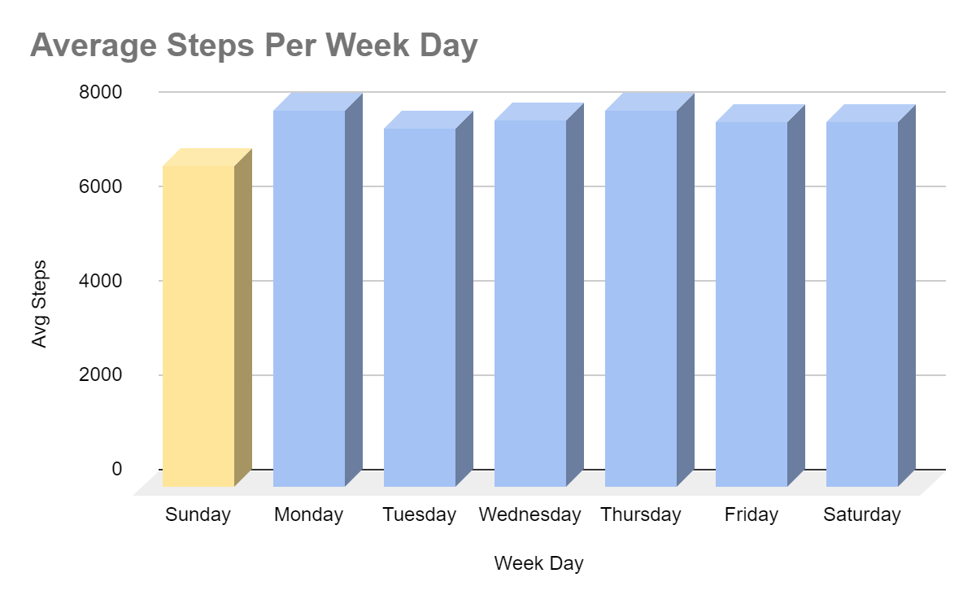
Visuals (1/4) steps
While individual users differ in their behavior, on average, all users take about 1000 fewer steps on Sunday compared to the rest of the week.

Slide 15
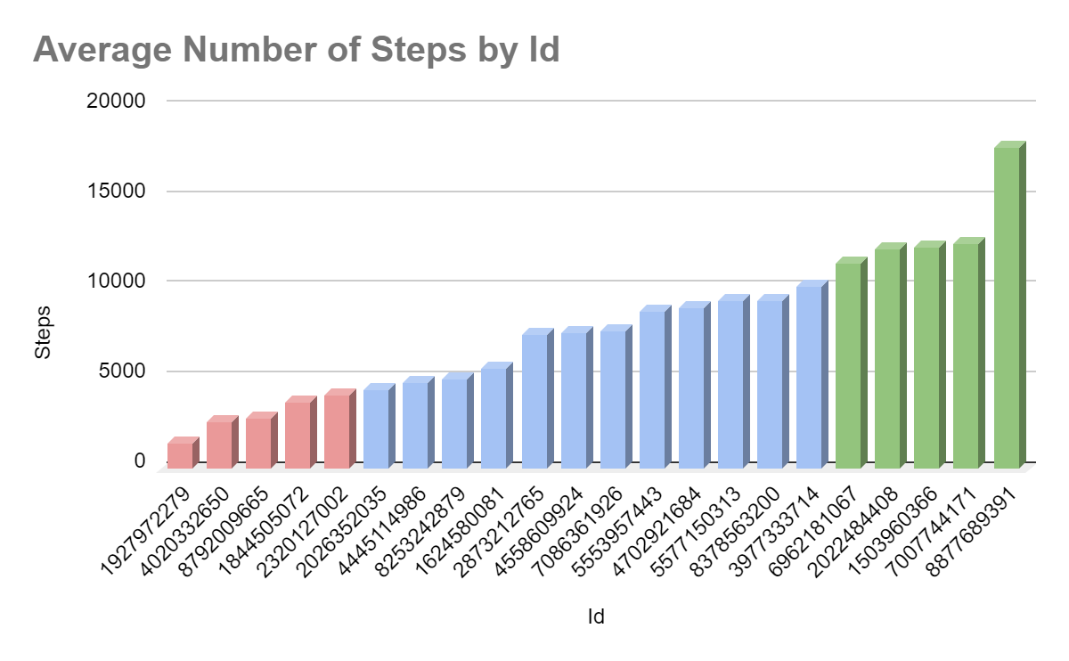
Visuals (2/4) steps
I decided to focus on the 5 most and 5 least active users for much of my analysis.
I determined who was most and least active by average number of daily steps.

Slide 16
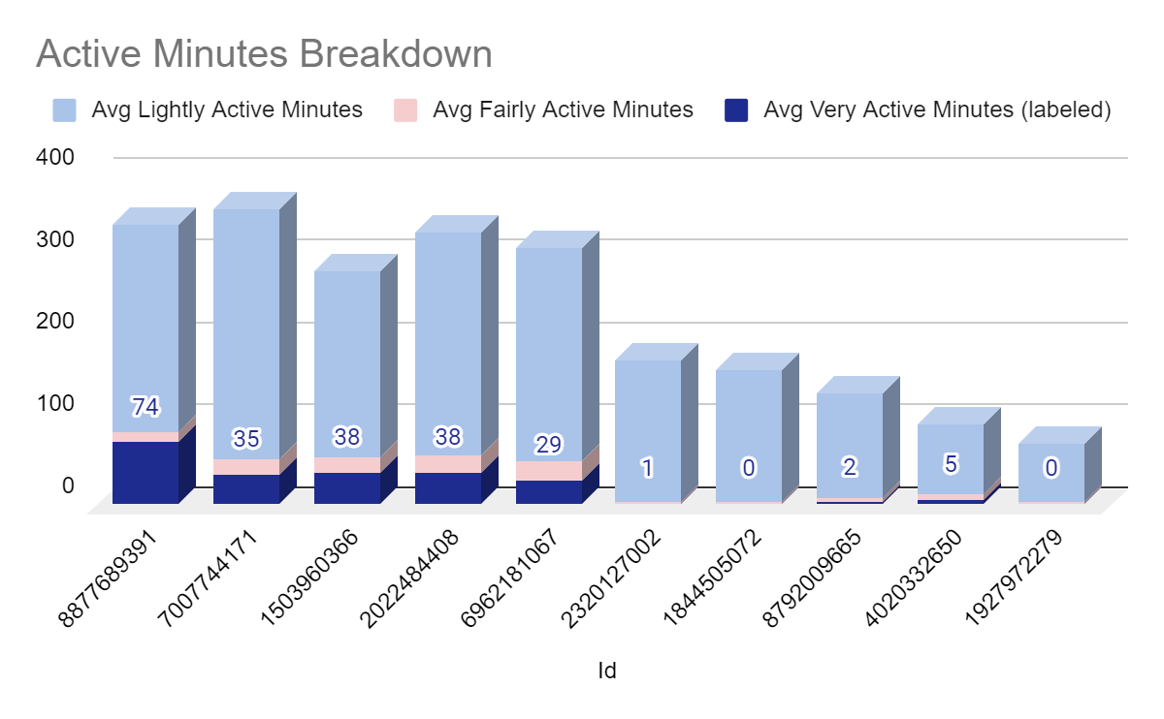
Visuals (3/4) Active Minutes
This chart shows which types of “activity minutes” contribute to each user’s overall activity minutes.
The most active users tend to have higher overall minutes and higher “very active” minutes, indicating dedicated workout time during the day.

Slide 17
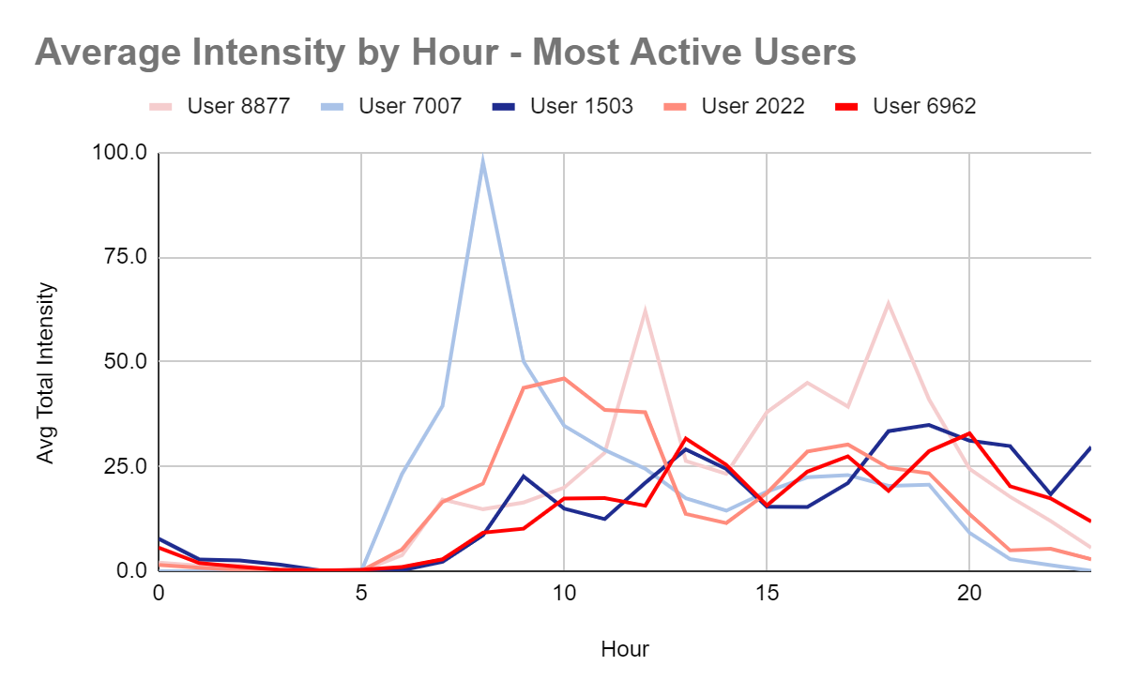
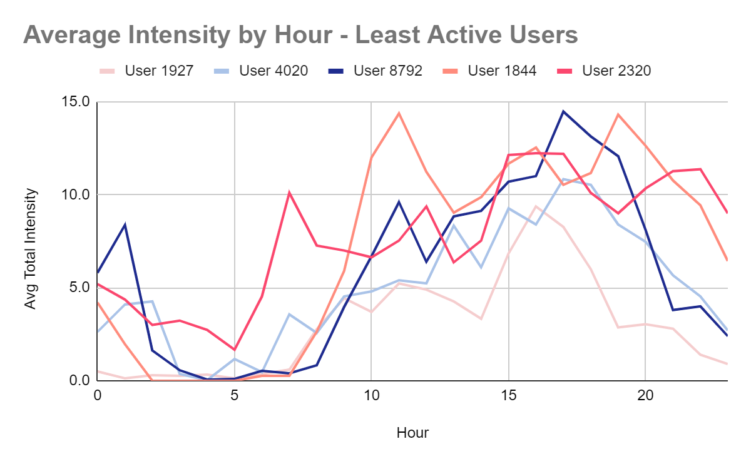
Visuals (4/4) hourly intensities
The most active users tend to have spikes of intensity in the morning and the early evening while least active users tend to have more steady low-level intensity throughout the day, peaking in the late evening.
Least active users tend to stay up later than the most active users.

Slide 18
Conclusion: Two Market Segments
My analysis with the provided FitBit data has revealed two groups of fitness wearable users.
The active group is characterized by more daily steps, more intensity, and more activity minutes.
The inactive group has fewer of these metrics across the board.
I believe Bellabeat should use a unique approach to target each of these groups.

Slide 19
Targeting active users
Active users tend to have spikes of activity in the morning and after work which indicate dedicated workout times during the day.
Active users tended to be more likely to log their sleep and weight data, indicating more consistent use of the product overall.
The Time product from Bellabeat is the best suited product for this group as it allows the user to collect more accurate data than Bellabeat’s other products.
In order to target active users, Bellabeat should focus on advertising agreements with gyms and fitness clubs in which these organizations can offer their members group discounts on the products.

Slide 20
Targeting Inactive users
Inactive users tend to have consistent, low-level intensity throughout the day as well as getting almost all of their activity from “fairly active” and “lightly active” minutes.
Inactive users also tend to stay up later than active users and are less likely to log data on weight and sleep.
For users that are less focused on the details of their daily activity data, Bellabeat’s Leaf product is an inconspicuous and low barrier to entry option.
For inactive users, Bellabeat should utilize social media and influencer marketing to focus on its more aesthetically pleasing products like the Leaf line.

Slide 21
APPENDIX 1 – Data Set Description
Below is the description of the FitBit dataset provided via Kaggle.
“This dataset generated by respondents to a distributed survey via Amazon Mechanical Turk between 03.12.2016-05.12.2016. Thirty eligible Fitbit users consented to the submission of personal tracker data, including minute-level output for physical activity, heart rate, and sleep monitoring. Individual reports can be parsed by export session ID (column A) or timestamp (column B). Variation between output represents use of different types of Fitbit trackers and individual tracking behaviors / preferences.”

Slide 22
APPENDIX 2 – Description of tables
dailyActivity
Contains distance, activity minutes, and calories for 35 unique user Ids over the established date range
Distance and activity minutes are further subdivided into “Very Active”, “Moderately Active”, “Lightly Active”, and “Sedentary” categories
hourlyIntensities
Contains total and average “intensity” for users by the hour over the date range
hourlyCalories
Contains calories for users by the hour over the date range
Heartrate_seconds
Contains user heartrate by second of the date range
sleepDay
Contains daily sleep data for users over the date range
weightLogInfo
Contains weight in kg and lbs, a column called “Fat”, and BMI for users by day over the date range

Slide 23
APPENDIX 3.1 – Data processing Code
¹SELECT *
FROM `project.dataset.dailyActivity_merged_part1`
UNION ALL
SELECT *
FROM `project.dataset.dailyActivity_merged_part2`
²SELECT DISTINCT *
FROM `project.dataset.dailyActivity_complete`
³SELECT
Id,
COUNT(*) AS number_of_user_records
FROM
`project.dataset.dailyActivity_combined`
GROUP BY
Id
ORDER BY
number_of_user_records

Slide 24
APPENDIX 3.2 – Data processing Code
⁴SELECT
ActivityDate,
COUNT(*) AS number_of_users
FROM project.dataset.dailyActivity_combined
GROUP BY
ActivityDate
ORDER BY
ActivityDate
⁵SELECT *
FROM
project.dataset.dailyActivity_combined
WHERE
EXTRACT(MONTH FROM ActivityDate) = 04
ORDER BY
Id,
ActivityDate

Slide 25
APPENDIX 3.3 – Data processing Code
⁶SELECT DISTINCT *
FROM `project.dataset.dailyActivity_March_2016`
WHERE
ActivityDate != "2016-04-12"
ORDER BY
ActivityDate

Slide 26
APPENDIX 3.4 – Data processing Code
⁷SELECT *
FROM
`project.dataset.dailyActivity_March_2016_RevB`
WHERE Id IN (
SELECT
Id
FROM (
SELECT
Id,
COUNT(*) AS number_of_entries
FROM `project.dataset.dailyActivity_March_2016_RevB`
GROUP BY
Id
ORDER BY
number_of_entries
)
WHERE
number_of_entries = 29
)
ORDER BY
Id
⁸SELECT
Id,
CAST(CONCAT(Date," ",Time) AS DATETIME) AS DateTime,
Value
FROM (
SELECT
Id,
PARSE_DATE('%m/%d/%Y', Date_unformatted) AS Date,
PARSE_TIME("%I:%M:%S %p", Time_unformatted) AS Time,
Value
FROM (
SELECT
Id,
LEFT(Time, STRPOS(Time, " ")) AS Date_unformatted,
RIGHT(Time, LENGTH(Time)-STRPOS(Time, " ")) AS Time_unformatted,
Value
FROM
project.dataset.heartrate_seconds_merged_part2
)
)

Slide 27
APPENDIX 4.1 – Data Analysis Code
⁹SELECT *
FROM
`project.dataset.HourlyIntensities_DupesRemoved`
WHERE Id = 8877689391
AND EXTRACT(YEAR FROM DateTime) = 2016
AND EXTRACT(MONTH FROM DateTime) = 4
ORDER BY
DateTime

